Slide 1
BIG DATA CHALLENGE
SHAASTRA 2019
TEAM - DATA DRIVERS
E. Naveen
I. Hariharan
MID PRICE PREDICTION

Slide 2
FINAL PIPELINE
Metrics
Quote IN
Metrics
Train Classification
Training Score
Train Regression
Trade IN
Features Engineering
Fine Tuning
Quote OUT
Regression Model
Test
Score
Classification Model
Trade OUT
Mid Price Predictions

Slide 3

R2 SCORE 0.98 ??

Slide 4
FEATURES
DATETIME date and time of record
SYM system used to record data
BSIZE bid size of quote
BID bid price of quote
ASIZE ask size of quote
ASK ask price of quote
MID average of ASK and BID
MID CHANGE GROUP every change in mid price is specified by a group number

Slide 5
FEATURES
FUT MID future mid price to predict
TICK FUT MIID - MID
TICK SIZE absolute value of TICK
TICK DIR direction of MID PRICE movement
IMBALANCE ( BSIZE - ASIZE ) / ( BSIZE + ASIZE)
SHARE IMBALANCE BSIZE/( BSIZE + ASIZE)

Slide 6
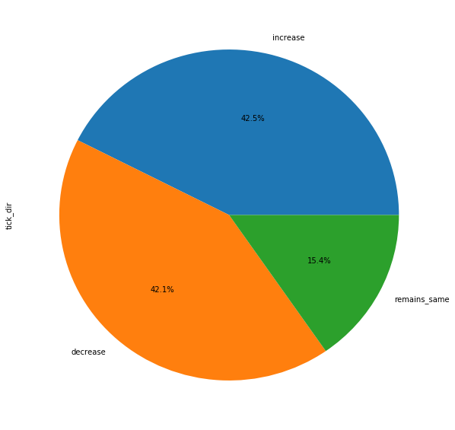
EXPLORATORY DATA ANALYSIS
PROPORTION OF LABELS

Slide 7
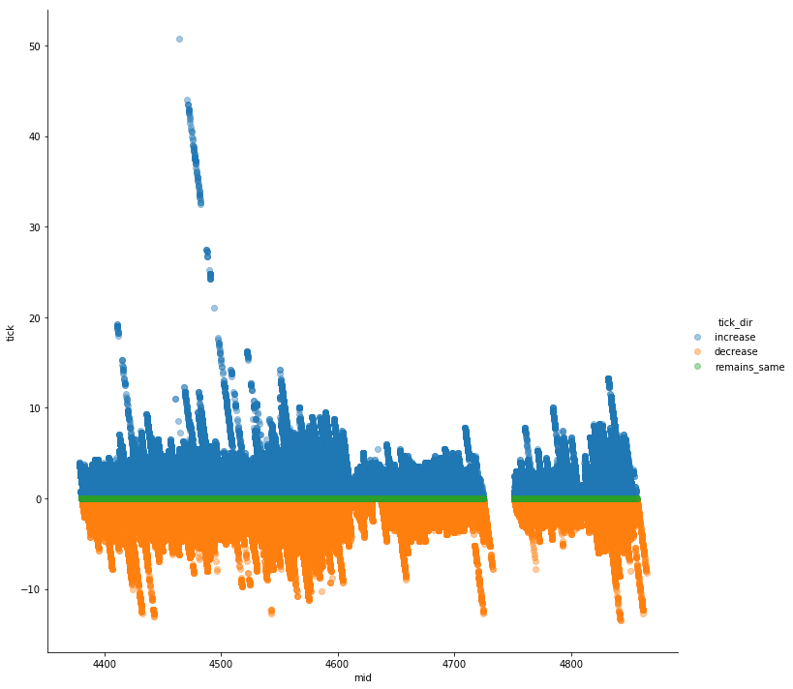
EXPLORATORY DATA ANALYSIS
TICK VS MID PRICE

Slide 8
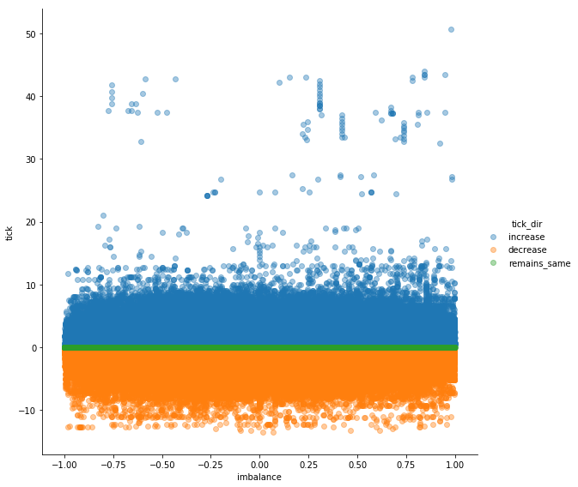
EXPLORATORY DATA ANALYSIS
TICK VS IMBALANCE

Slide 9
FEATURE ENGINEERING - EMA
EMA lines are used by Technical Analysts to predict stock movements
Difference between EMAs were used as features

Slide 10
FEATURE ENGINEERING - TIME BASED
Day of Week
Date-Time Features
Seconds from market start
Time elapsed from last time step

Slide 11
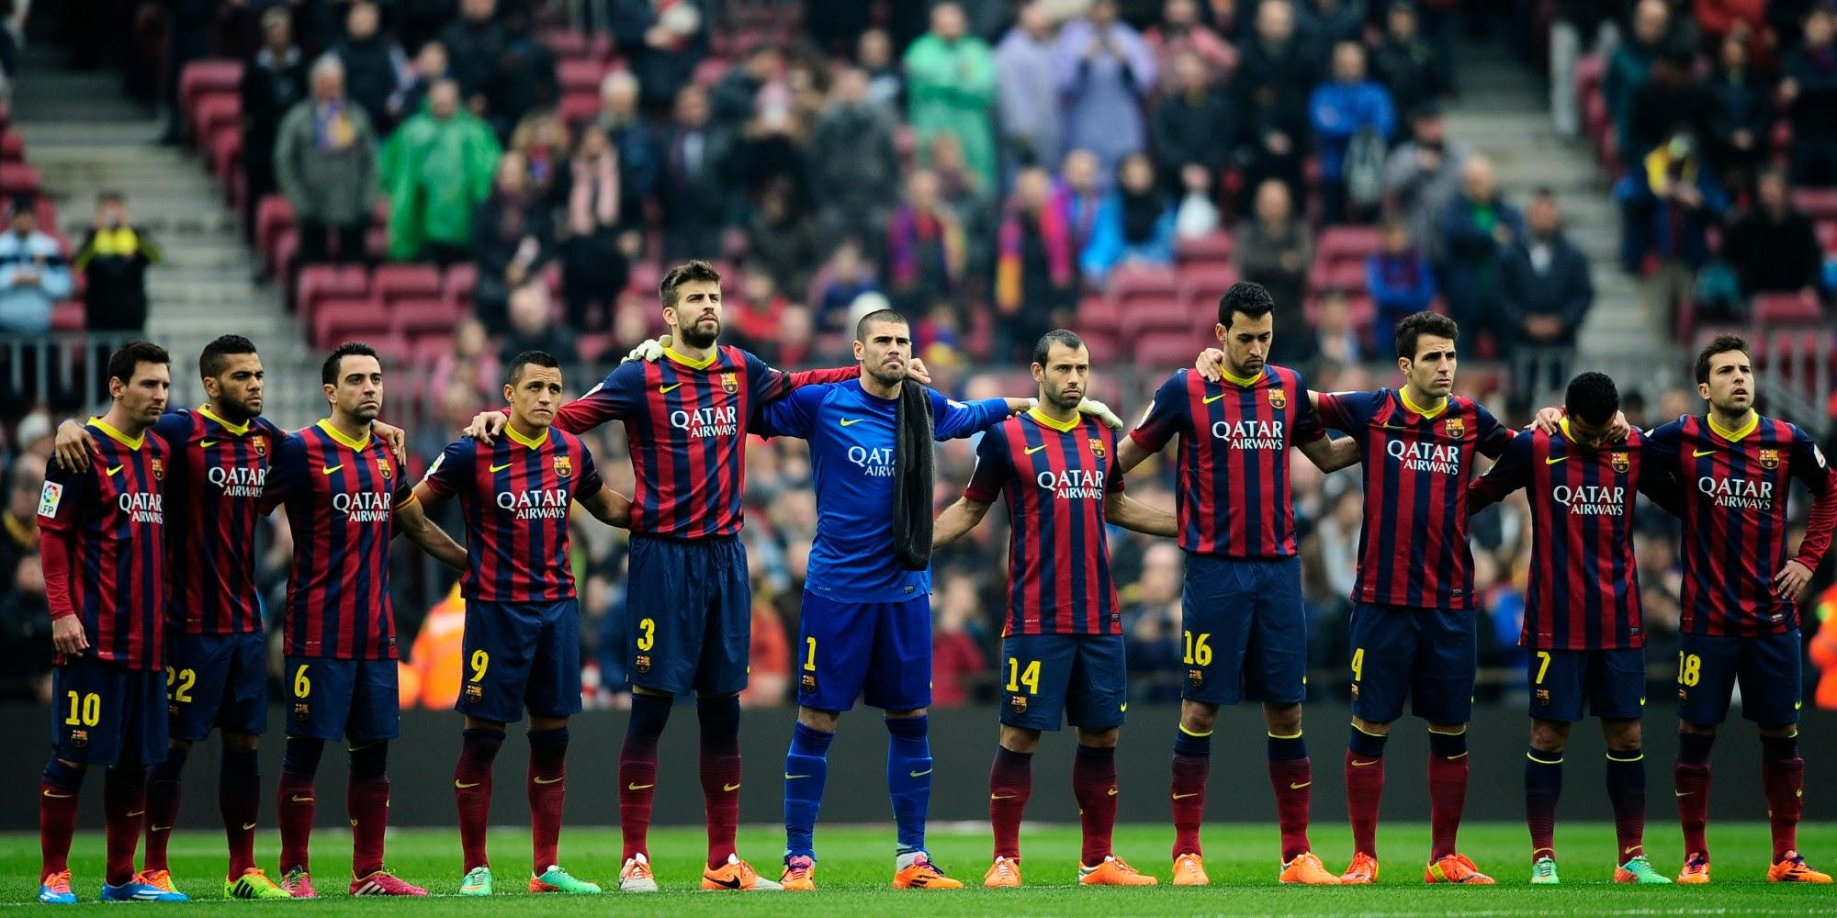
THE TEAM
MOVING AVERAGE
MID PRICE
TRADE SIZE
BID PRICE
SECONDS
ASK SIZE
TRADE PRICE
IMBALANCE
BID SIZE
DAY OF
WEEK
ASK PRICE

Slide 12
CLASSICAL MODELS USED
Voting Classifier
Random Forest Classifier
Classification
Extra Trees Classifier
Bagging Classifier
Gradient Boosting Classifier

Slide 13
CLASSICAL MODELS USED
Random Forest Regressor
Extra Trees Regressor
Regression
Bagging Regressor
Gradient Boosting Regressor

Slide 14
FINAL PIPELINE
Metrics
Quote IN
Metrics
Train Classification
Training Score
Train Regression
Trade IN
Features Engineering
Fine Tuning
Quote OUT
Regression Model
Test
Score
Classification Model
Trade OUT
Mid Price Predictions

Slide 15
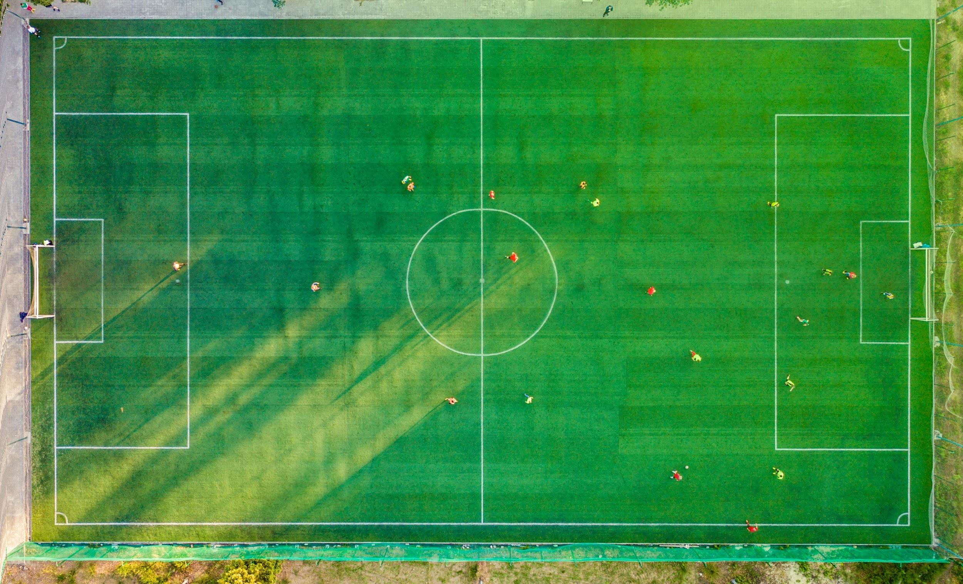
STRATEGY
BAGGING CLASSIFIER
CLASSIFICATION
BAGGING REGRESSOR
RANDOM FOREST
EXTRA TREES
REGRESSION

Slide 16
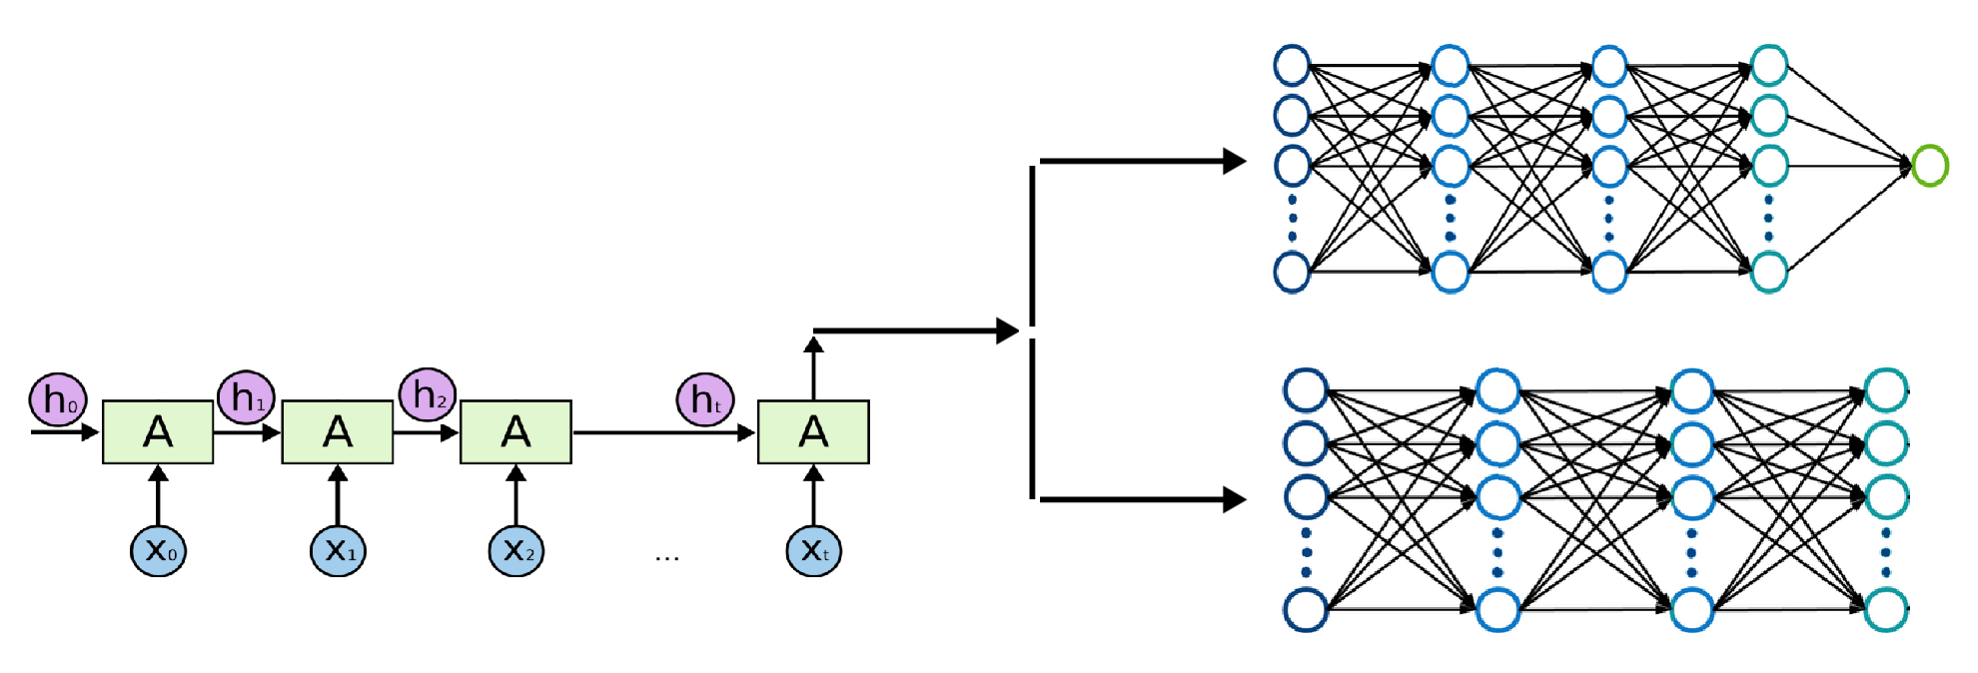
RECURRENT NEURAL NETWORK
REGRESSION NETWORK
dropout
dropout
DYNAMIC RNN
dropout
CLASSIFICATION NETWORK

Slide 17
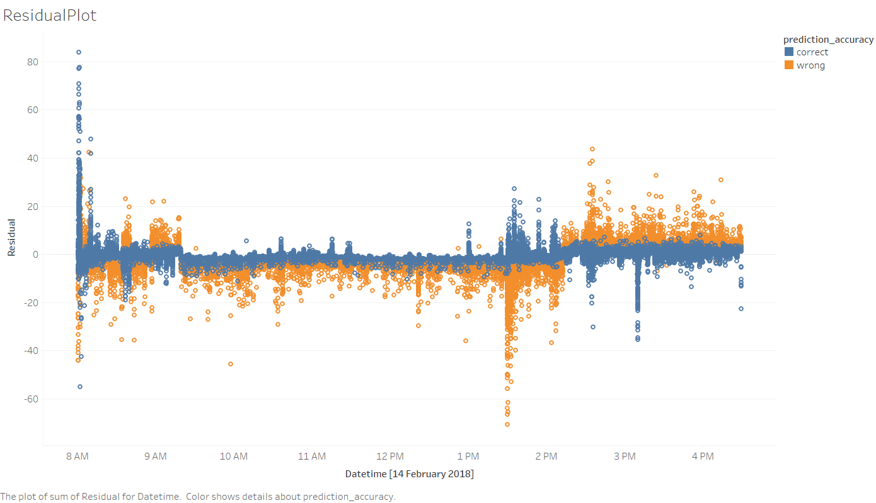
RESULT AND MANUAL TWEAKING

Slide 18


SCORE
TRAIN
RMS : 1.202
TEST
RMS : 1.106

